Slide 1
CASA0011: Agent-Based Modelling
Dr Sarah WISE
Dr Thomas OLÉRON EVANS
s.wise@ucl.ac.uk
thomas.evans.11@ucl.ac.uk
Moodle password: ABM20
Centre for Advanced
Spatial Analysis,
90 Tottenham Court Road

Slide 2
LECTURE 8A Investigating Models

Slide 3
OBJECTIVES 1. Consider a case study on investigating, visualising and measuring model outcomes.

Slide 4
Course Objectives
You should...
1. understand the principles of
agent-based modelling (ABM).
2. be able to describe the type and range of systems to which ABM can be profitably and appropriately applied.
3. be able to conceptualise and model
urban systems with complex dynamics.
4. show evidence of being able to translate your
understanding into the practical methodology of modelling

Slide 5
The ABM Course
Week 1: Introduction to ABMs
Week 2: Cellular Automata
Week 3: ABM Methodology
Week 4: Agent Behaviours
Week 5: ABMs as Research Tools
READING WEEK
Week 6: Presenting Results & GIS Integration
Week 7: Modelling Competitive Agents
Week 8: Investigating Models & Further GIS
Week 9: Verification and Validation of ABMs
Week 10: Applications of Agent Based Modelling

Slide 6
Feedback

Slide 7
Final Project

Slide 8
Example – 1D Single Species B Models

Slide 9
Example – 1D Single Species B Models
E
E
E
S
SET UP
Ring of cells
Two states: S, E
Each iteration: Select a cell at random; Select a neighbour at random;
Apply the transition rule
S
S
E
S
E
E
E
E
S
E
E
E
E
S
S
S
E
E
E
E

Slide 10
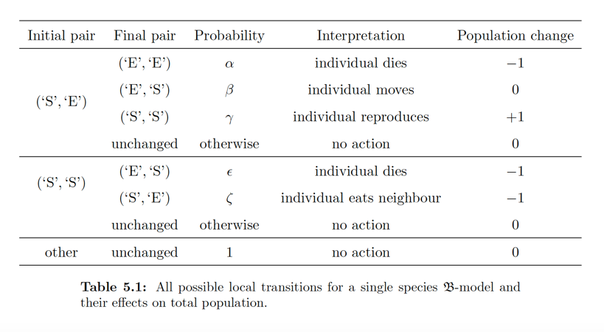
Example – Single Species B Models

Slide 11
Example – Single Species B Models
η = ε + ζ

Slide 12
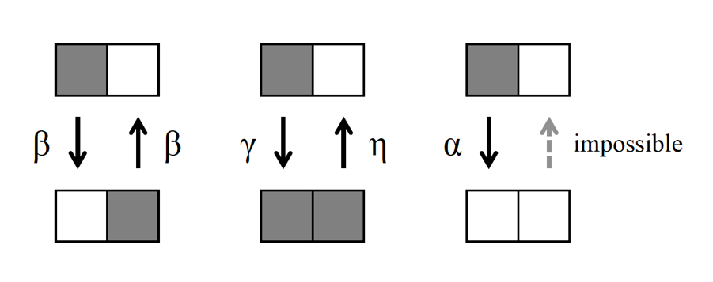
Example – Single Species B Models

Slide 13
Example – Single Species B Models
OBJECTIVE
Understand the complete range
of behaviours of the model

Slide 14
Example – Single Species B Models
Parameter Space: Probabilities α, β, γ, η

Slide 15
Example – Single Species B Models
Parameter Space:
Parameters α, β, γ (η = 0)
Parameters α*, β*, γ* (η ≠ 0)

Slide 16


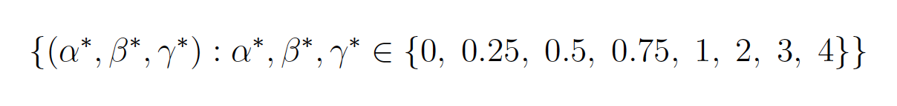
Example – Single Species B Models
Exploratory Systematic Search
η = 0
η ≠ 0
1000 cells, 1.6 million iterations, 10 repetitions
Complete state recorded every 3200 iterations

Slide 17
Example – Single Species B Models
Approach 1 – Visualisation

Slide 18
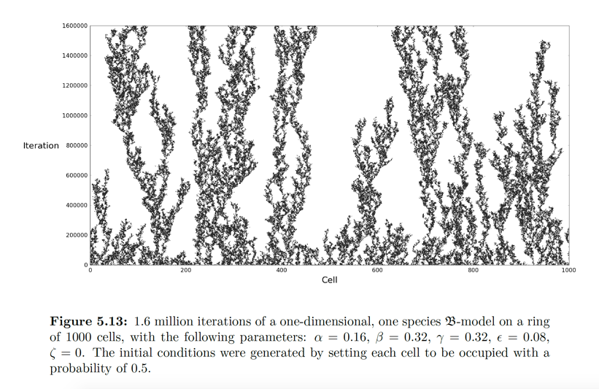
Example – Single Species B Models
Approach 1 – Full System Visualisation

Slide 19
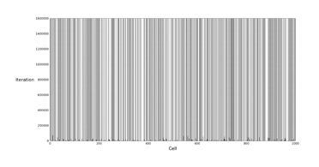
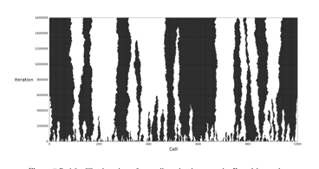
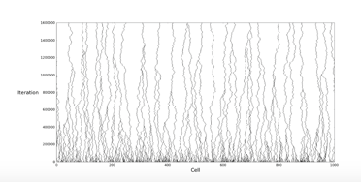
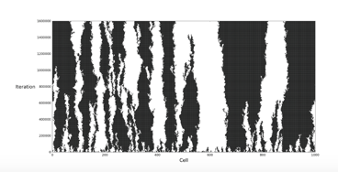
Example – Single Species B Models
Approach 1 – Full System Visualisation
Allowed me to catalogue different behavioural
types and associate them with parameter values

Slide 20
Example – Single Species B Models
Approach 1I – Studying a single metric
Population Density

Slide 21
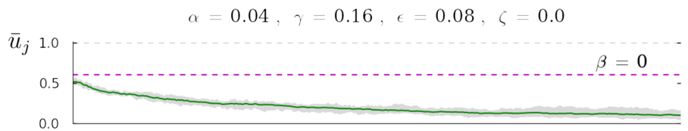

Example – Single Species B Models
Approach 1I – Studying a single metric
Population Density

Slide 22
Example – Single Species B Models
Approach 1I – Studying a single metric
Population Density
(Was 10 repetitions sufficient?)

Slide 23
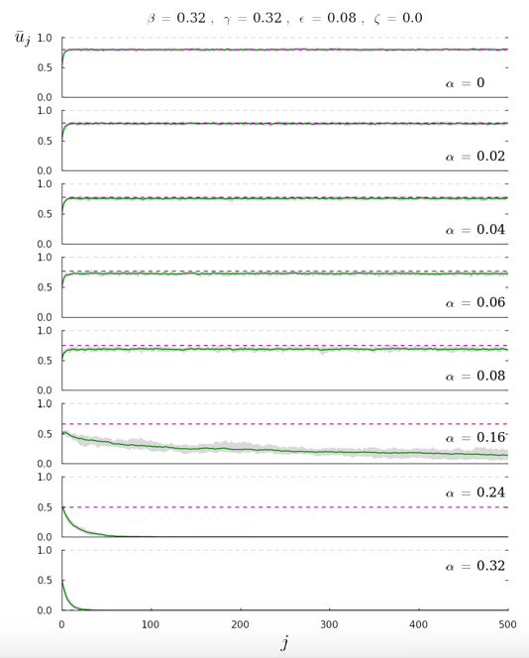
Example – Single Species B Models
Approach 1I
Studying a single metric
Vary one variable, while holding others constant

Slide 24
Example – Single Species B Models
Approach 1I
Studying a single metric
Vary one variable, while holding others constant
‘Warm-Up’
Period

Slide 25
Example – Single Species B Models
Approach 1I
Studying a single metric
Vary one variable, while holding others constant
Suggested a new metric:
Long-term equilibrium population density

Slide 26
Example – Single Species B Models
Approach III – Mapping the Parameter Space

Slide 27
Example – Single Species B Models
Approach III – Mapping the Parameter Space
Challenge: 3 or 4 dimensions
Complications: Did the population settle down?
Additional Information: Theoretical Equilibria
How to visualise?

Slide 28
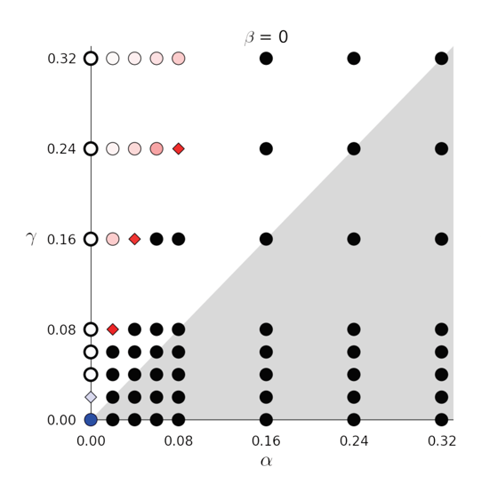
Example – Single Species B Models
Approach III – Mapping the Parameter Space
( η ≠ 0 )

Slide 29
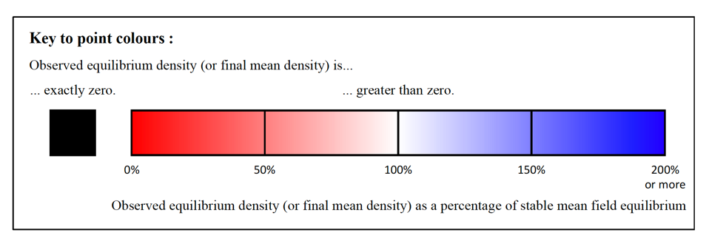
Example – Single Species B Models
Approach III – Mapping the Parameter Space

Slide 30
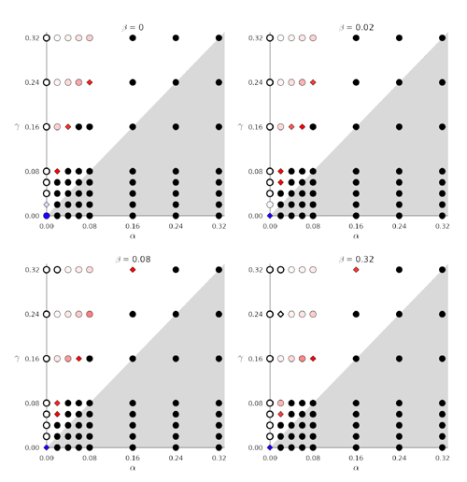
Example – Single Species B Models
Approach III – Mapping the Parameter Space
( η ≠ 0 )

Slide 31
Example – Single Species B Models
Approach IV+ – More complicated metrics

Slide 32
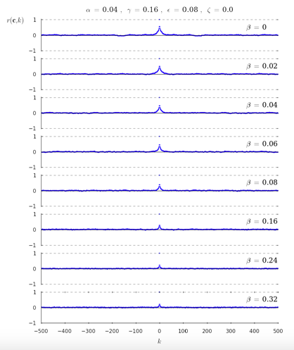

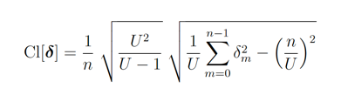
Example – Single Species B Models
Approach IV+ – More complicated metrics
Empirical Autocorrelation
Agent Clumping

Slide 33
Example – Single Species B Models
Approach IV+ – Alternative Visualisations

Slide 34
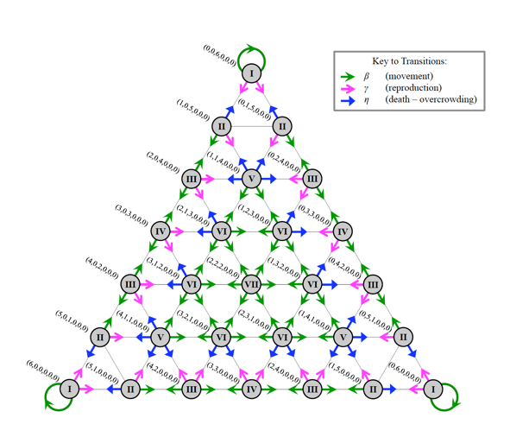
Example – Single Species B Models
Approach IV+ – Alternative Visualisations

Slide 35
OBJECTIVES 1. Consider a case study on investigating, visualising and measuring model outcomes.

